Slide 1
Absolute value of price change &
Trading volume
Correlation

Slide 2
METHODOLOGY
Stocks
Pepsi
Google
Ford
Visual assessment
Probable causes
Hypothesis testing

Slide 3
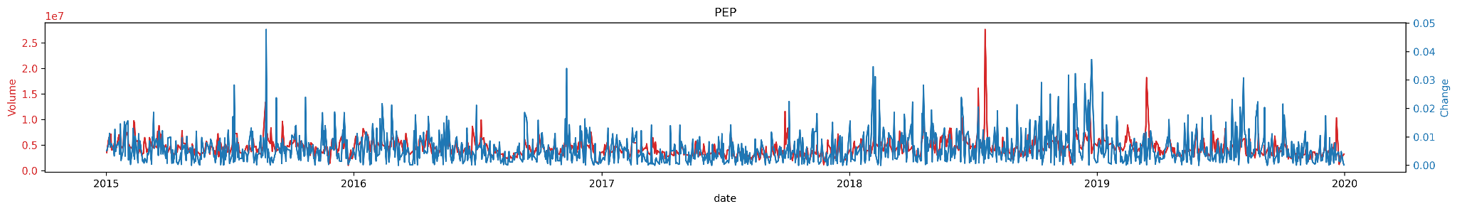
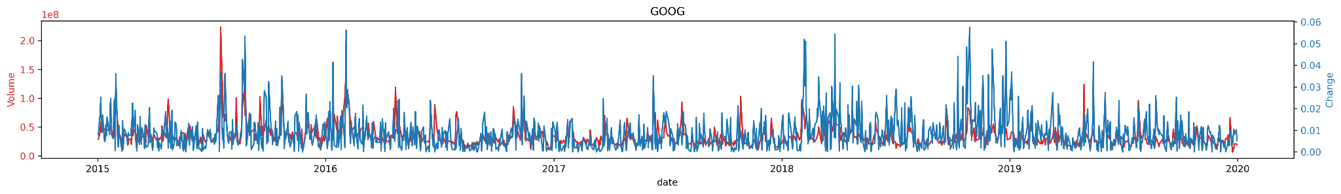
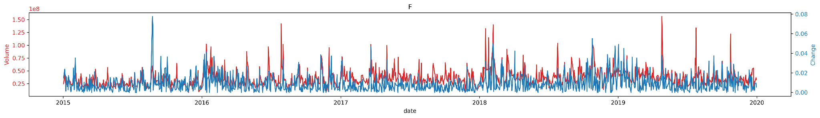

Slide 4
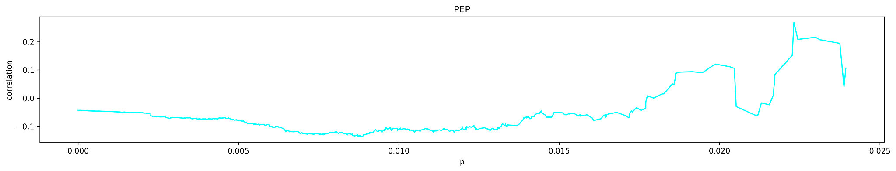
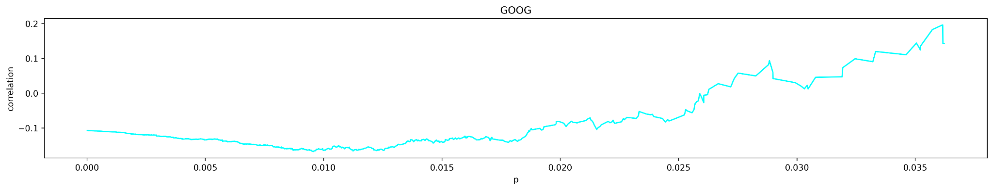
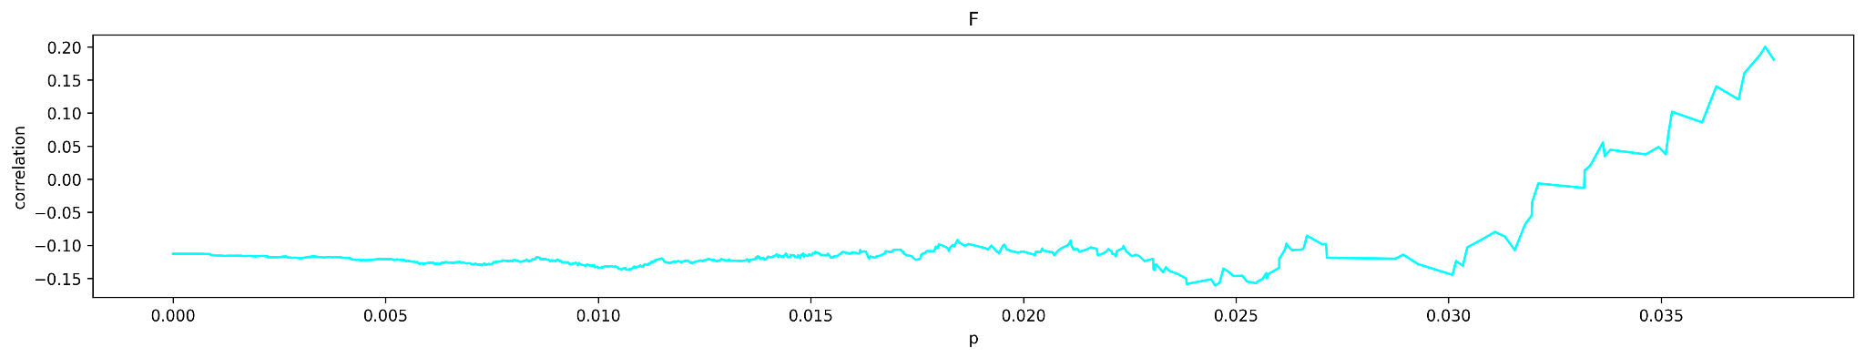

Slide 5
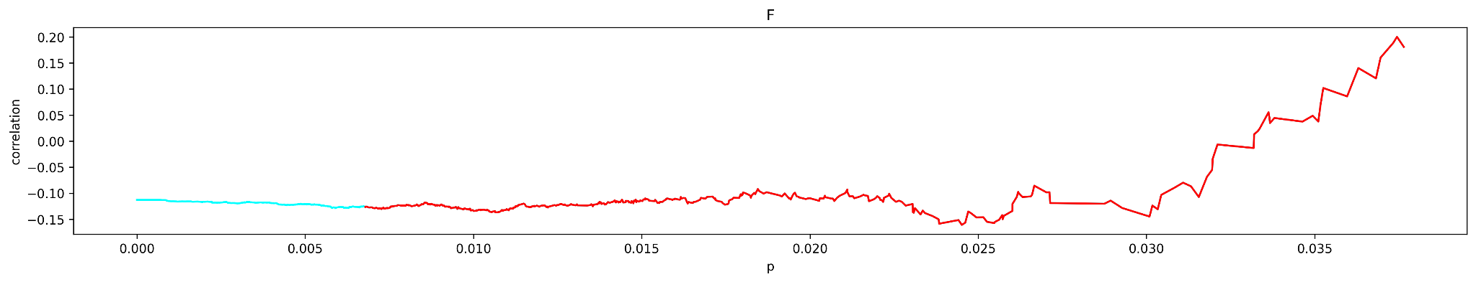
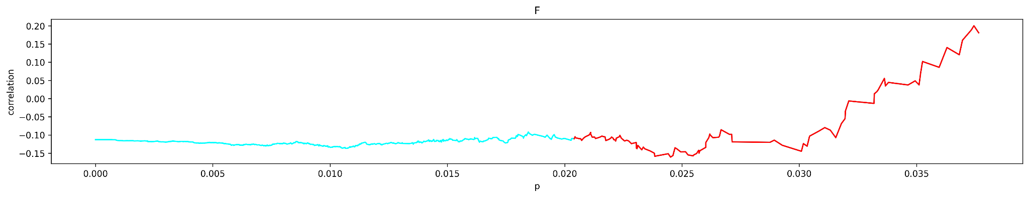
Probable causes

Slide 6
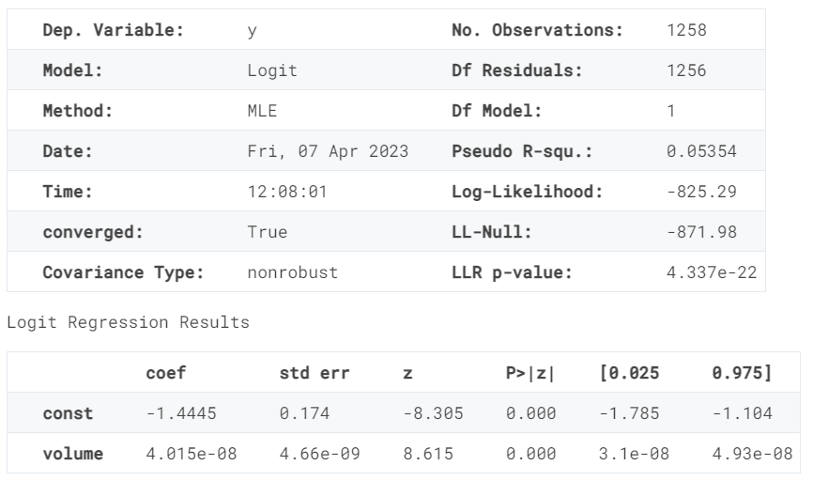
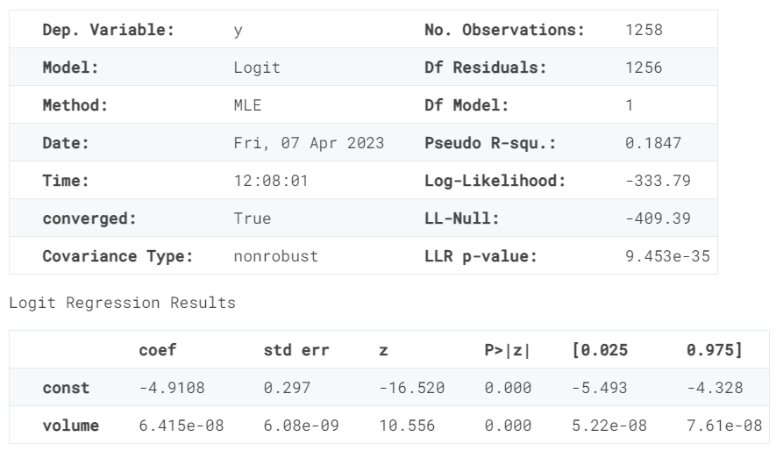
Hypothesis testing

Slide 7
 | PEP | GOOG | F
Pseudo R^2 | 0.03460 | 0.07486 | 0.05354
Quantile Pseudo R^2 | 0.08580 | 0.1718 | 0.1847

Slide 8

Conclusion
We can see that there indeed is a correlation between volume and absolute price change of the stock. Moreover, we have shown that this correlation actually becomes stronger with larger changes.

